Slide 1


Qualitative Research: What’s it all about?
Dr Katherine Howard
Digital Research Analyst
Intersect Australia

Slide 2
Who or What is Intersect?
Non-profit eResearch technology company
Formed in 2008 with state (NSW) and federal grants
Jointly owned and directed by a consortium of 11 Australian Universities (our Members)
Operating across 4 states and territories: NSW, ACT, SA, Vic.
What do we do?
Training in digital tools and technology from Awareness to Advanced levels (Python, R, NVivo, Qualtrics et al.)
Research support
High Performance Compute (HPC) service @UniSA

Slide 3
What is Knowledge?
Put your hand up if you believe …
There is a reality (a world) that exists independent of human consciousness and experience, and this reality (world) is discoverable through impartial observation
OR …
There is no ‘external’ reality just waiting to be found, that nothing exists outside of our thoughts. Reality is human experience, and human experience is reality.
Notes:
CF
How does Intersect support Researcher Skill Development programs?
We currently have 11 institutions across 4 states and territories
Intersect Member institutions receive 15 full days of training selected from Intersect’s Course Catalogue
Intersect’s Digital Research Analyst works with Graduate Research Development (UniSA) and the Graduate Research School (UoA) to tailor courses to meet the needs of each university
Administrative burden of recording candidates registration and attendance from Intersect’s registrations reduced with a fully automated Google Sheet which harvests data from Intersect’s Eventbrite pages which is then pushed to the UniSA and UoA systems respectively

Slide 4
What do you see?
Notes:
CF
How does Intersect support Researcher Skill Development programs?
We currently have 11 institutions across 4 states and territories
Intersect Member institutions receive 15 full days of training selected from Intersect’s Course Catalogue
Intersect’s Digital Research Analyst works with Graduate Research Development (UniSA) and the Graduate Research School (UoA) to tailor courses to meet the needs of each university
Administrative burden of recording candidates registration and attendance from Intersect’s registrations reduced with a fully automated Google Sheet which harvests data from Intersect’s Eventbrite pages which is then pushed to the UniSA and UoA systems respectively

Slide 5
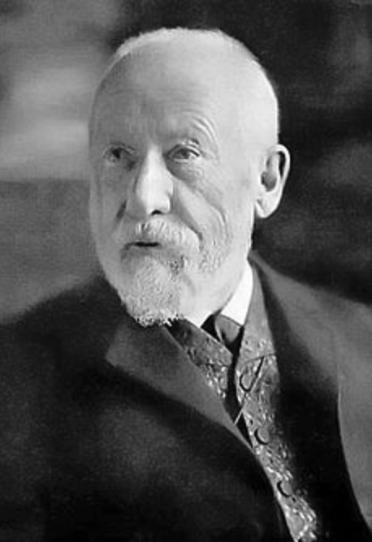
Wilhelm Dilthey 1833 - 1911 German historian, psychologist, sociologist, and hermeneutic philosopher
Two types of knowledge:
Verstehen = understanding and
Erklärung = explanation
Two types of science:
Naturwissenschaften = natural sciences and
Geisteswissenschaften = cultural, human, moral or social sciences
Notes:
CF
How does Intersect support Researcher Skill Development programs?
We currently have 11 institutions across 4 states and territories
Intersect Member institutions receive 15 full days of training selected from Intersect’s Course Catalogue
Intersect’s Digital Research Analyst works with Graduate Research Development (UniSA) and the Graduate Research School (UoA) to tailor courses to meet the needs of each university
Administrative burden of recording candidates registration and attendance from Intersect’s registrations reduced with a fully automated Google Sheet which harvests data from Intersect’s Eventbrite pages which is then pushed to the UniSA and UoA systems respectively

Slide 6
What is the purpose of our research?
If it is to explain something (Erklärung), then Positivist methods and methodologies are appropriate i.e. Quantitative
If it is to understand something (Verstehen) then methods and methodologies other than quantitative are appropriate i.e. Qualitative
Notes:
CF
How does Intersect support Researcher Skill Development programs?
We currently have 11 institutions across 4 states and territories
Intersect Member institutions receive 15 full days of training selected from Intersect’s Course Catalogue
Intersect’s Digital Research Analyst works with Graduate Research Development (UniSA) and the Graduate Research School (UoA) to tailor courses to meet the needs of each university
Administrative burden of recording candidates registration and attendance from Intersect’s registrations reduced with a fully automated Google Sheet which harvests data from Intersect’s Eventbrite pages which is then pushed to the UniSA and UoA systems respectively

Slide 7
Qualitative analysis task
Take the sheet of 24 qualitative responses to the question “Which parts of the course did you find most useful? Why?”
Analyse them!
are there similar responses?
do people say the same thing but use different words?
Feel free to work in pairs or small groups
Notes:
CF
How does Intersect support Researcher Skill Development programs?
We currently have 11 institutions across 4 states and territories
Intersect Member institutions receive 15 full days of training selected from Intersect’s Course Catalogue
Intersect’s Digital Research Analyst works with Graduate Research Development (UniSA) and the Graduate Research School (UoA) to tailor courses to meet the needs of each university
Administrative burden of recording candidates registration and attendance from Intersect’s registrations reduced with a fully automated Google Sheet which harvests data from Intersect’s Eventbrite pages which is then pushed to the UniSA and UoA systems respectively

Slide 8
Bibliography
Crotty, M (2003). The foundations of social research: Meaning and perspective in the research process, London, UK, SAGE Publications
Willis, J (2007). Chapter 4 History and foundations of Interpretivist research in Foundations of Qualitative Research: Interpretive and Critical Approaches Thousand Oaks, CA: SAGE Reference Online. http://dx.doi.org/10.4135/9781452230108.n4
Contact details
Katherine.howard@unisa.edu.au
Katherine.howard@intersect.org.au

